Slide 1
Sales Return
Lecturer: Tran Thi Anh

Slide 2
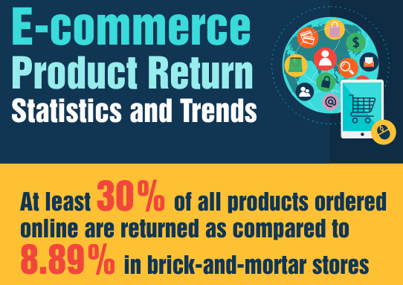
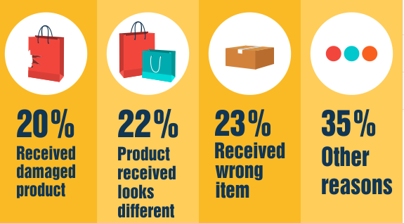
Notes:
Hư hỏng

Slide 3
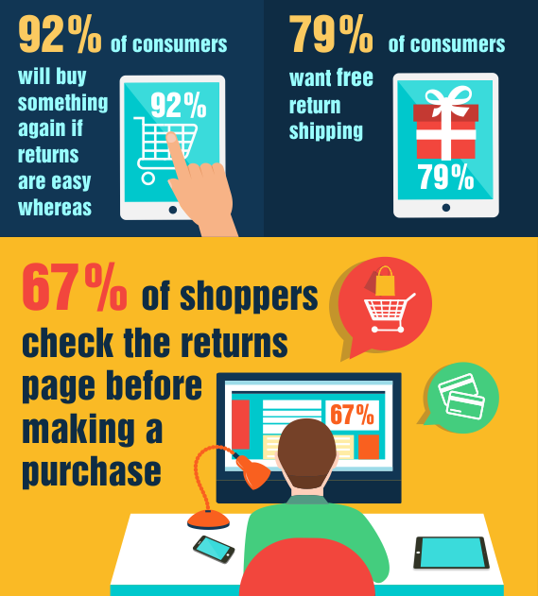

Slide 4
Returns
Ecommerce return rates are double and even 5x more than those of brick and mortar stores.
Reasons:
The “Try It On” Consumer
Size:
Quality:
Expectations:
Product images:
Fraud & Abuse:

Slide 5
Returns – What to improve
logistics of returns
Refund
Return policy
-> Work on accurate product titles, detailed product descriptions, size guides, matching your product’s attributes to those of the channel you’re listing it and so on.
-> Encourage Customers to Leave Product Reviews
-> Improve Order Fulfillment Accuracy
-> Decide Where to Ship a Returned Item Based on Product Categories, SKU types
-> Offer Competitive Return Deadlines
-> Allow In-Store Returns
-> Who Pays for Return Shipping?

Slide 6
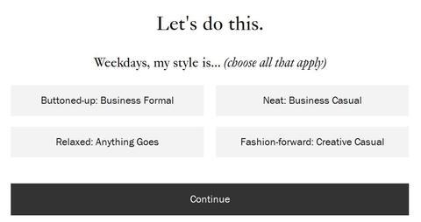
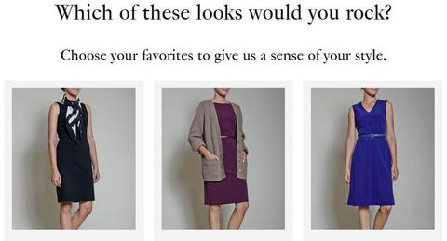
Returns – How to avoid
#1 Surveys for Liars

Slide 7
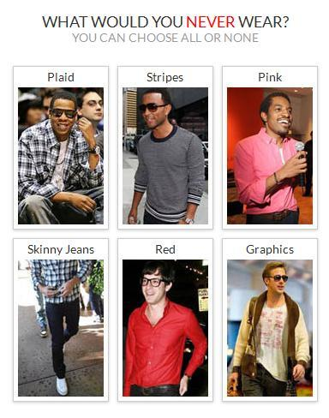
Returns – How to avoid
#2 Show Rather Than Tell

Slide 8

Returns – How to avoid
#3 Personalize the Experience

Slide 9
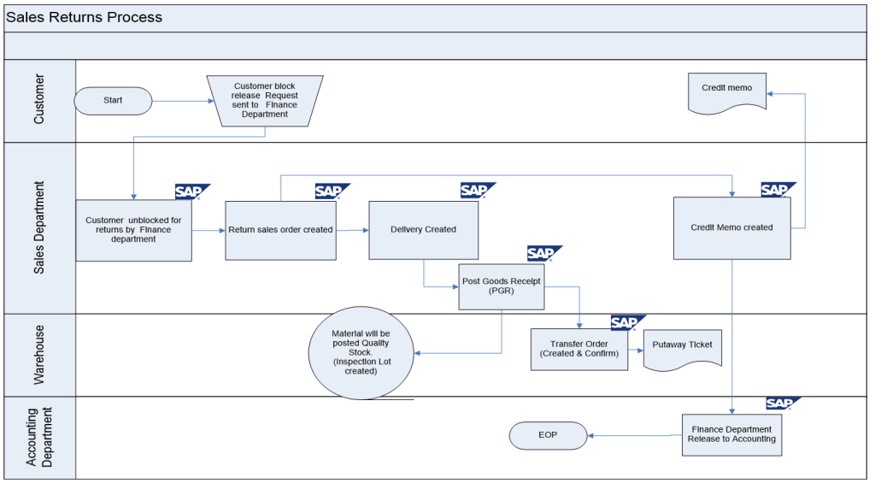

Slide 10
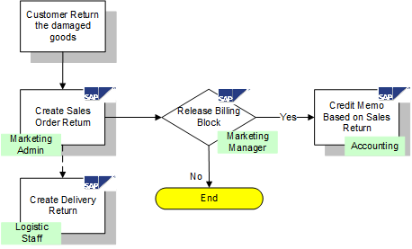
Return Sales order with Replacement
Notes:
-Khách hàng yêu cầu có hàng thay thế
Tạo đơn hàng

Slide 11
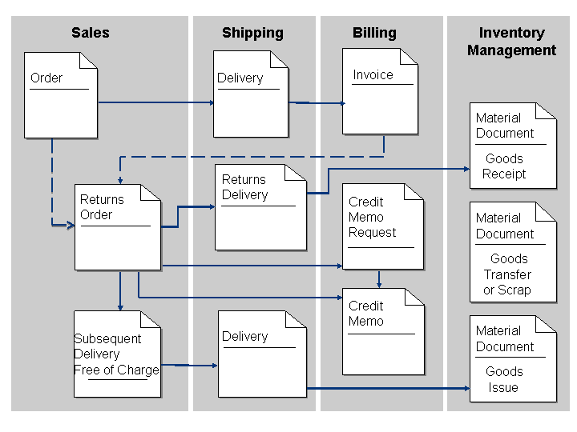
Return Sales Order Process

Slide 12
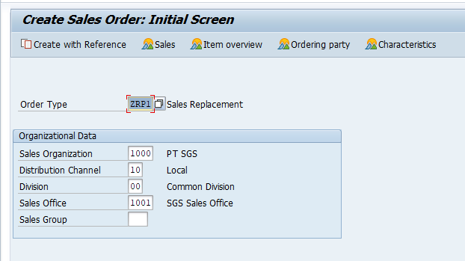
Return Sales order with Replacement
Notes:
-Khách hàng yêu cầu có hàng thay thế
Tạo đơn hàng

Slide 13
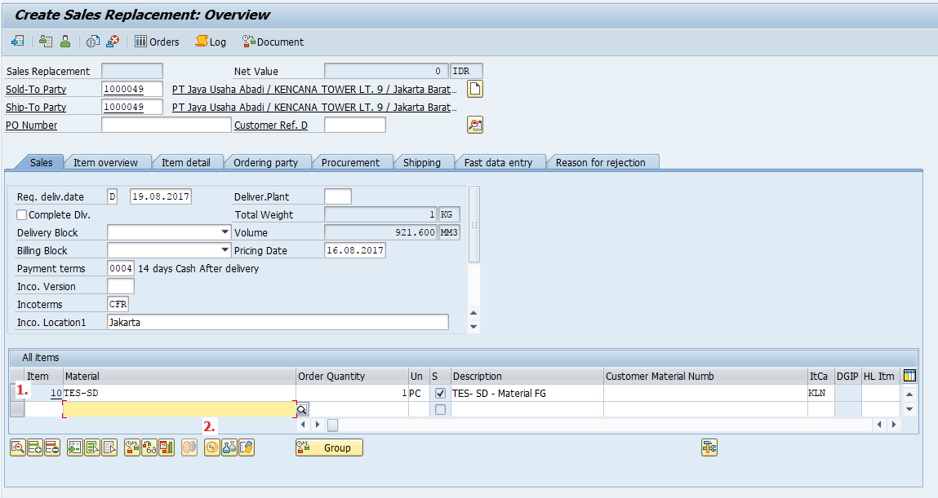
Return Sales order with Replacement
Notes:
-Khách hàng yêu cầu có hàng thay thế
Tạo đơn hàng

Slide 14
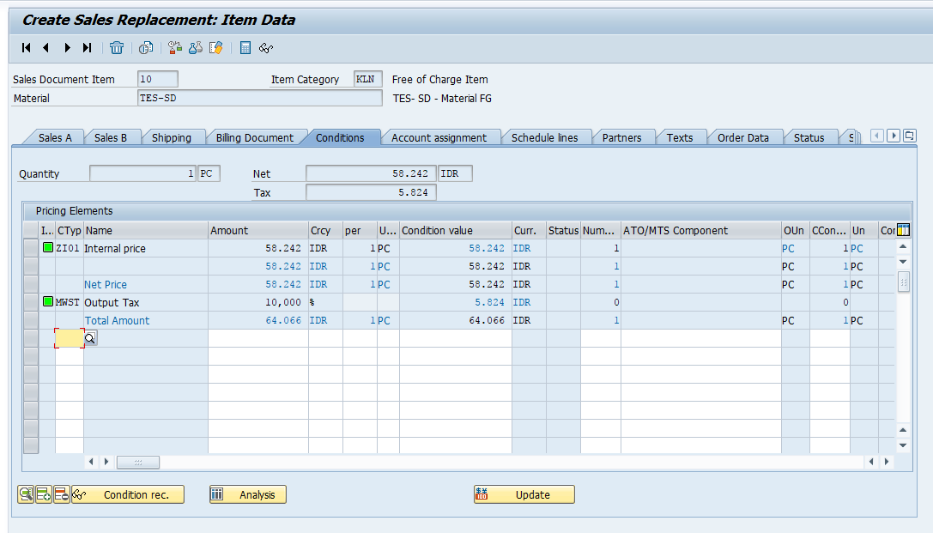
Return Sales order with Replacement
Notes:
-Khách hàng yêu cầu có hàng thay thế
Tạo đơn hàng

Slide 15
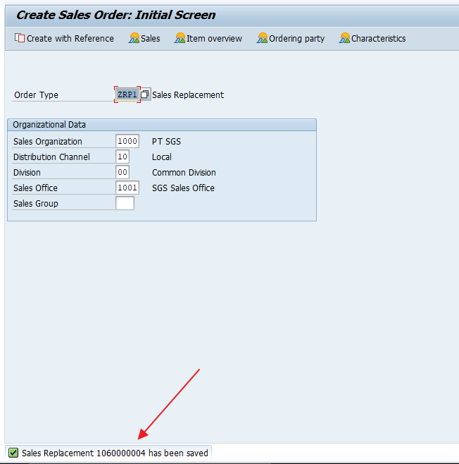
Return Sales order with Replacement
Notes:
-Khách hàng yêu cầu có hàng thay thế
Tạo đơn hàng

Slide 16
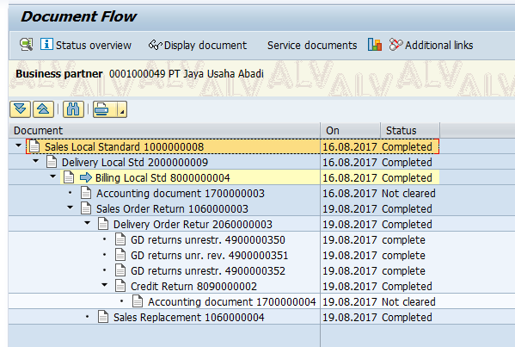
Return Sales order with Replacement
Notes:
-Khách hàng yêu cầu có hàng thay thế
Tạo đơn hàng

Slide 17
Return Sales order with Credit Memo
Notes:
Khách hàng trả hàng- công ty hoàn tiền
Lý do hoàn trả, số lượng khách hàng

Slide 18
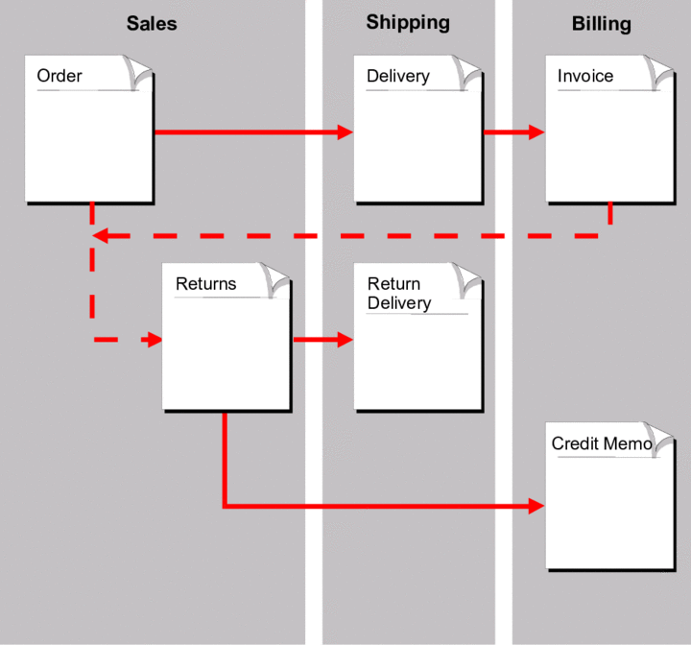

Slide 19
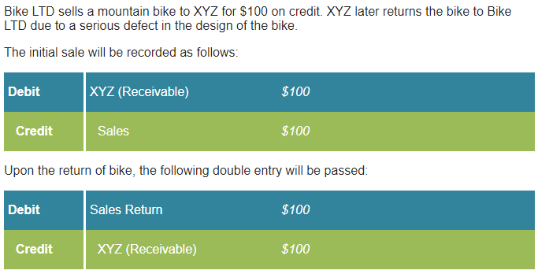

Slide 20
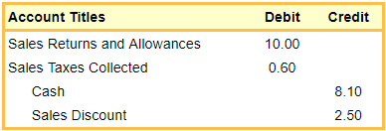

Merchandise returned for cash refund
Note: The selling price of the returned cups before the discount is $10 = $5 x 2 cups. The discount amount related to the two cups is $2.50 = $10 x 25%. The sales tax for the returned cups is $0.60 = ($10 - $2.50) x 8%.
The $3.00 is based on the cost of one cup and two cups returned: $3.00 = $1.50 x 2 cups.

